Slide 1


The Social World of Content Abusers in Community Question Answering
World Wide Web Conference
(WWW 2015)
Imrul Kayes¹, Nicolas Kourtellis², Daniele Quercia²,
Adriana Iamnitchi¹ and Francesco Bonchi²
¹University of South Florida – Florida, USA
²Yahoo Labs – Barcelona, Spain

Slide 2
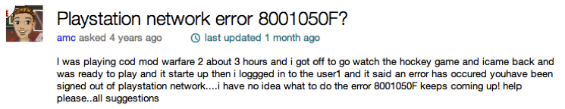
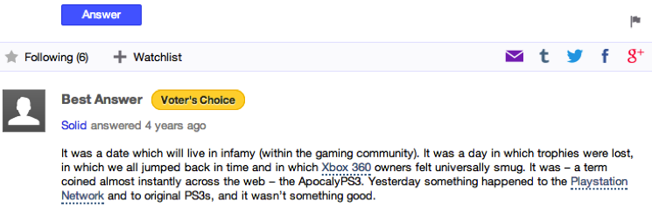
Community Question Answering (CQA)

Slide 3
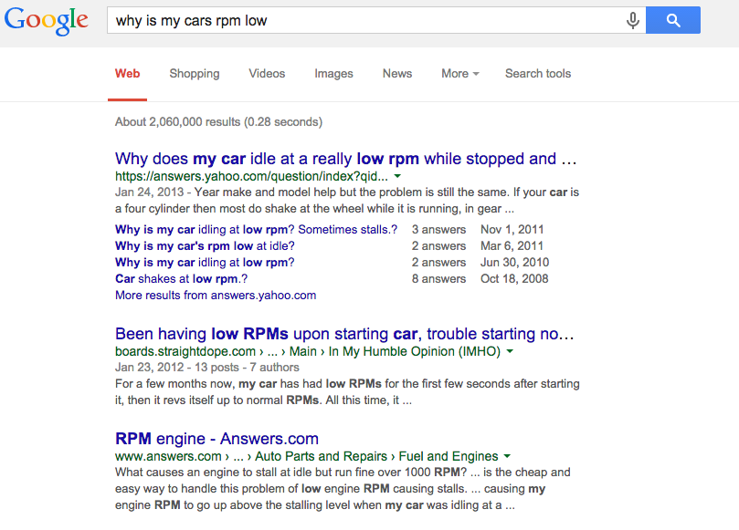
CQA: popular, informative, helpful
Quora: 3 times growth in a year (2013)
Yahoo Answers: >1B answers (2010)
Stack Overflow: 37.40% traffic from search engine

Slide 4
One common problem: content abusers
Members are expected to obey platform defined community rules.
Trolling, venting, ranting, hate speech, solicitation are common.
Abusive behavior has negative effects on the community.
It decreases community’s cohesion, performance and participation.
Users may leave or avoid the community.

Slide 5
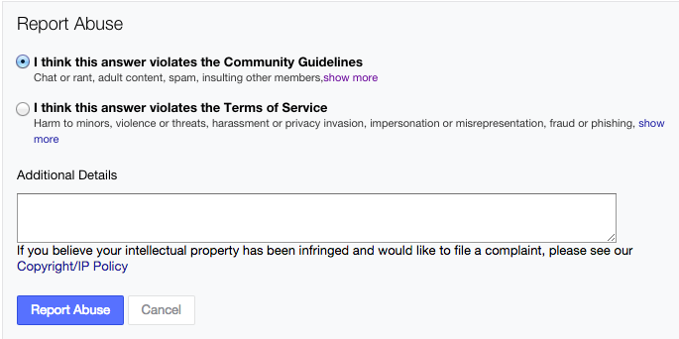
Solution: community monitoring and human moderation
Members flag inappropriate content.
Human moderators
Evaluate flags
Remove content
Suspend user accounts

Slide 6
Objective of this study
Our goal is to automate the detection of content abusers
To reduce the burden on human moderators.
How can we use crowd-sourced rule violation reports (flags) to detect content abusers?

Slide 7
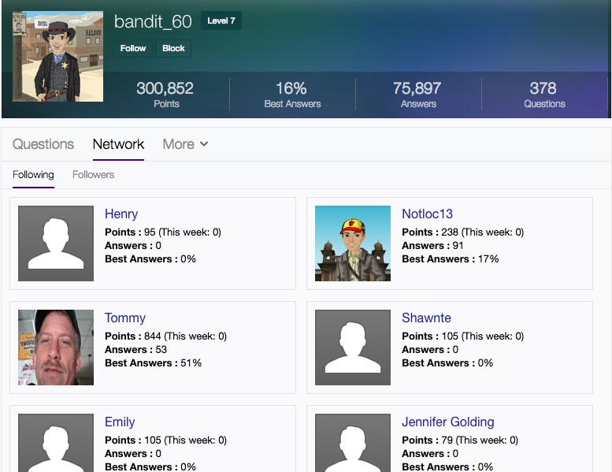
Dataset
Yahoo Answers (YA)
~1.5M users
~2.6M follow edges
~192M questions
~215M answers
~10M abuse reports (flags)
~9% suspended users (content abusers)

Slide 8
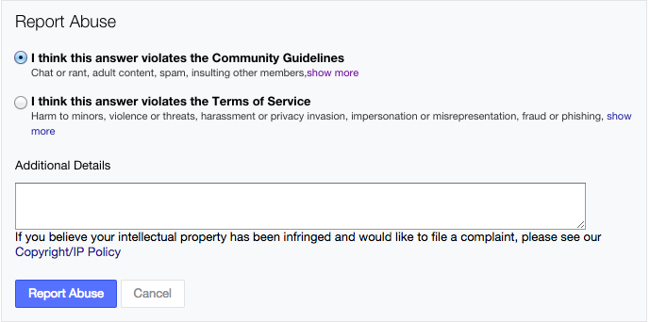
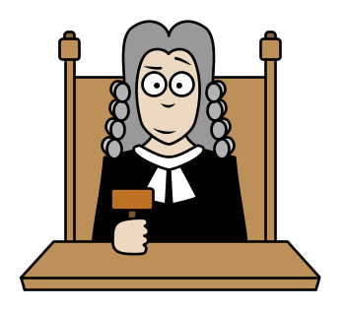

Are flags good proxies for content abuse?
Rule violation abuse reports (flags)
Editorially curated abuse reports
How good are users at flagging?
How quickly is correctly flagged content removed?

Slide 9
Community members are good at flagging
Questions
Answers
Flags reported vs. valid reported flags for questions (answers)
r = 0.80 (0.92), p<0.05
Flags received vs. valid received flags for questions (answers)
r = 0.90 (0.87), p<0.05

Slide 10
Are flags good proxies for content abuse?
How good are users at flagging?
How quickly is correctly flagged content removed?

Slide 11
Flagged content is quickly removed
~97% of reported questions and answers are deleted the same day.
All reported questions and answers are deleted within three days.
50% of the bad posts are reported within 10 minutes of posting.

Slide 12
Can we use flags to detect content abusers?
Common wisdom: content abusers receive many flags.
1% top flagged questioners (responders): 51.63% (53.89%) are suspended.
But, very active users tend to collect many flags.
Corr. (#questions, #valid flags) = 0.49, p < 0.05.
Corr. (#answers, #valid flags) = 0.37, p < 0.05.
So, activity matters.

Slide 13
Deviance Score
Indicates how much a user deviates from the norm in terms of received flags considering the amount of her activity.
Deviance_{Q/A} (u) = Y_{Q/A,u} − E(Y_{Q/A,u})
# correct flags
received for Q/A
# expected correct flags
received for Q/A
E(Y_{Q/A,u}) is computed by Y =α+βX+ε
# correct flags
# posts (Q/A)

Slide 14
Deviance score vs. suspension
Suspended users tend to have higher deviance scores than deviant (not suspended) users.

Slide 15
Are deviance scores enough to detect content abusers?
1% top flagged questioners (responders): 51.63% (53.89%) suspended.
1% top deviant questioners (responders): 63.94% (64.77%) suspended.
However, 40% of the suspended users
had never been flagged!

Slide 16
Deviance is not necessarily bad
Deviant users attract more answers.
Deviant users involve more users.

Slide 17
Moderate deviants can be beneficial

Slide 18
The suspended but not flagged users
Lower activity
Smaller social circles

Slide 19
Can we learn more about suspended users from the social network topology?

Slide 20
The social network channels attention
Users receive more answers from close neighborhood.

Slide 21
The social network monitors behavior
Social: 75% reports are from within 5 social hops.
Random: 9% reports are from within 5 social hops.
Higher probability of being flagged by close neighbors.

Slide 22
The social network shows homophily in the deviance score
r= Assortativity coefficient
Homophily : (non)deviant users tend to be close to each other.

Slide 23
Can we detect content abusers?
29 Features

Slide 24
Experimental setup

Slide 25
Classification performance
^{4.11%}

Slide 26
Feature importance

Slide 27
Summary
Lessons learned from study of flagging content in Yahoo Answers:
Flags are overwhelmingly correct.
Deviance metric demonstrates better performance than flags in detecting content abusers.
Deviance is not necessarily bad, but extreme deviants are suspended.
The social network channels attention, monitors behavior and shows homophily.
Automatic classification of content abusers is possible with 83% accuracy.

Slide 28

Questions?

Slide 29
Additional slides

Slide 30
Power law degree distribution
α: 3.53 for indegree and 2.95 for outdegree

Slide 31
Flagged questions and answers
27% users have more than 25% flagged questions, about 34% users have more than 25% flagged answers.
~16% and 19% of users have more than 50% flagged
questions and answers respectively.

Slide 32
Average answer and responders received per question

Slide 33
The social network coordinates behaviors

Slide 34
Confusion Matrix

